Slide 1
Liberty Mutual Fire Peril Loss Cost Prediction
Ruonan Ding & Frank Wang
6/26/2016

Slide 2
Agenda
Feature Selection:
Overview
Feature Engineering
Model selection:
Ran multiple models in parallel with Normalized Gini metric to rank them
Selected 3 promising models based on their 5-CV scores and trained them on 100% data
XGBoosting Regressor
Gradient Boosting Regressor

Slide 3
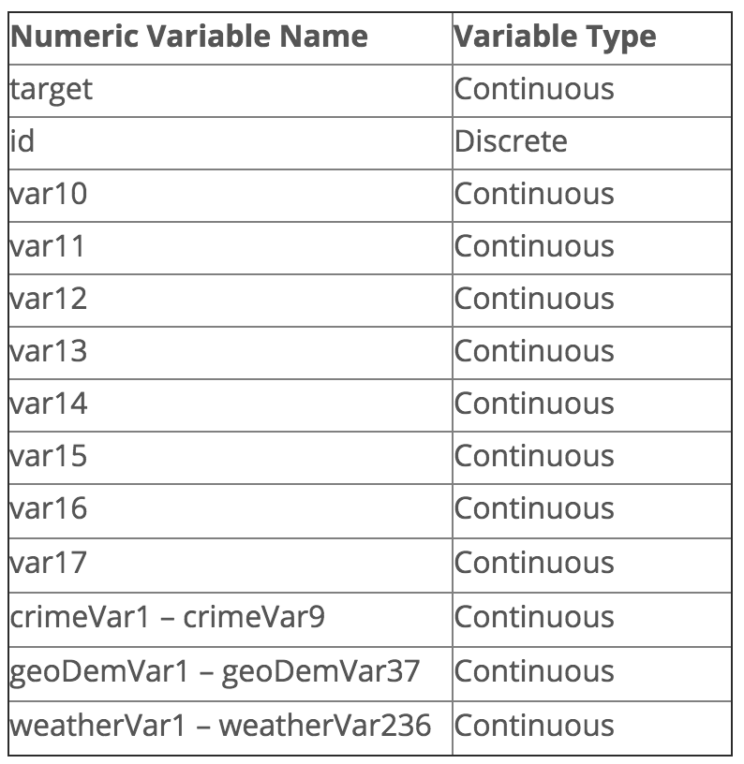
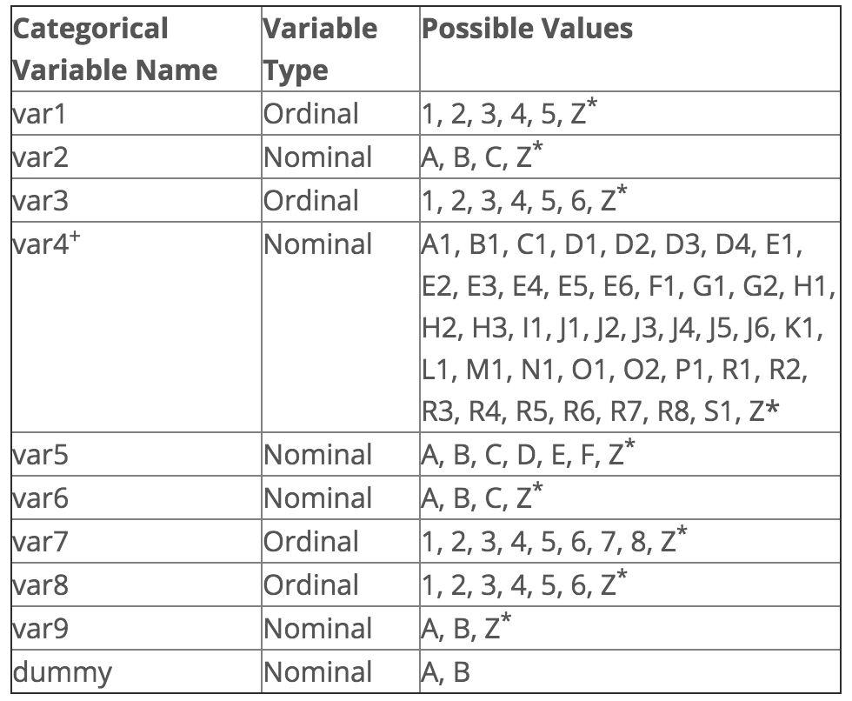
Feature Selections:
Competition Goal: is to predict the loss cost of total insured value of these insurance policies.
Challenge: Low Frequency + High Severity

Slide 4
Feature Selections:
id : A unique identifier of the data set
target : The transformed ratio of loss to total insured value
dummy : Nuisance variable used to control the model, but not working as a predictor
var1 – var17 : A set of normalized variables representing policy characteristics (note: var11 is the weight used in the weighted gini score calculation)
crimeVar1 – crimeVar9: A set of normalized Crime Rate variables
geodemVar1 – geodemVar37 : A set of normalized geodemographic variables
weatherVar1 – weatherVar236 : A set of normalized weather station variables

Slide 5
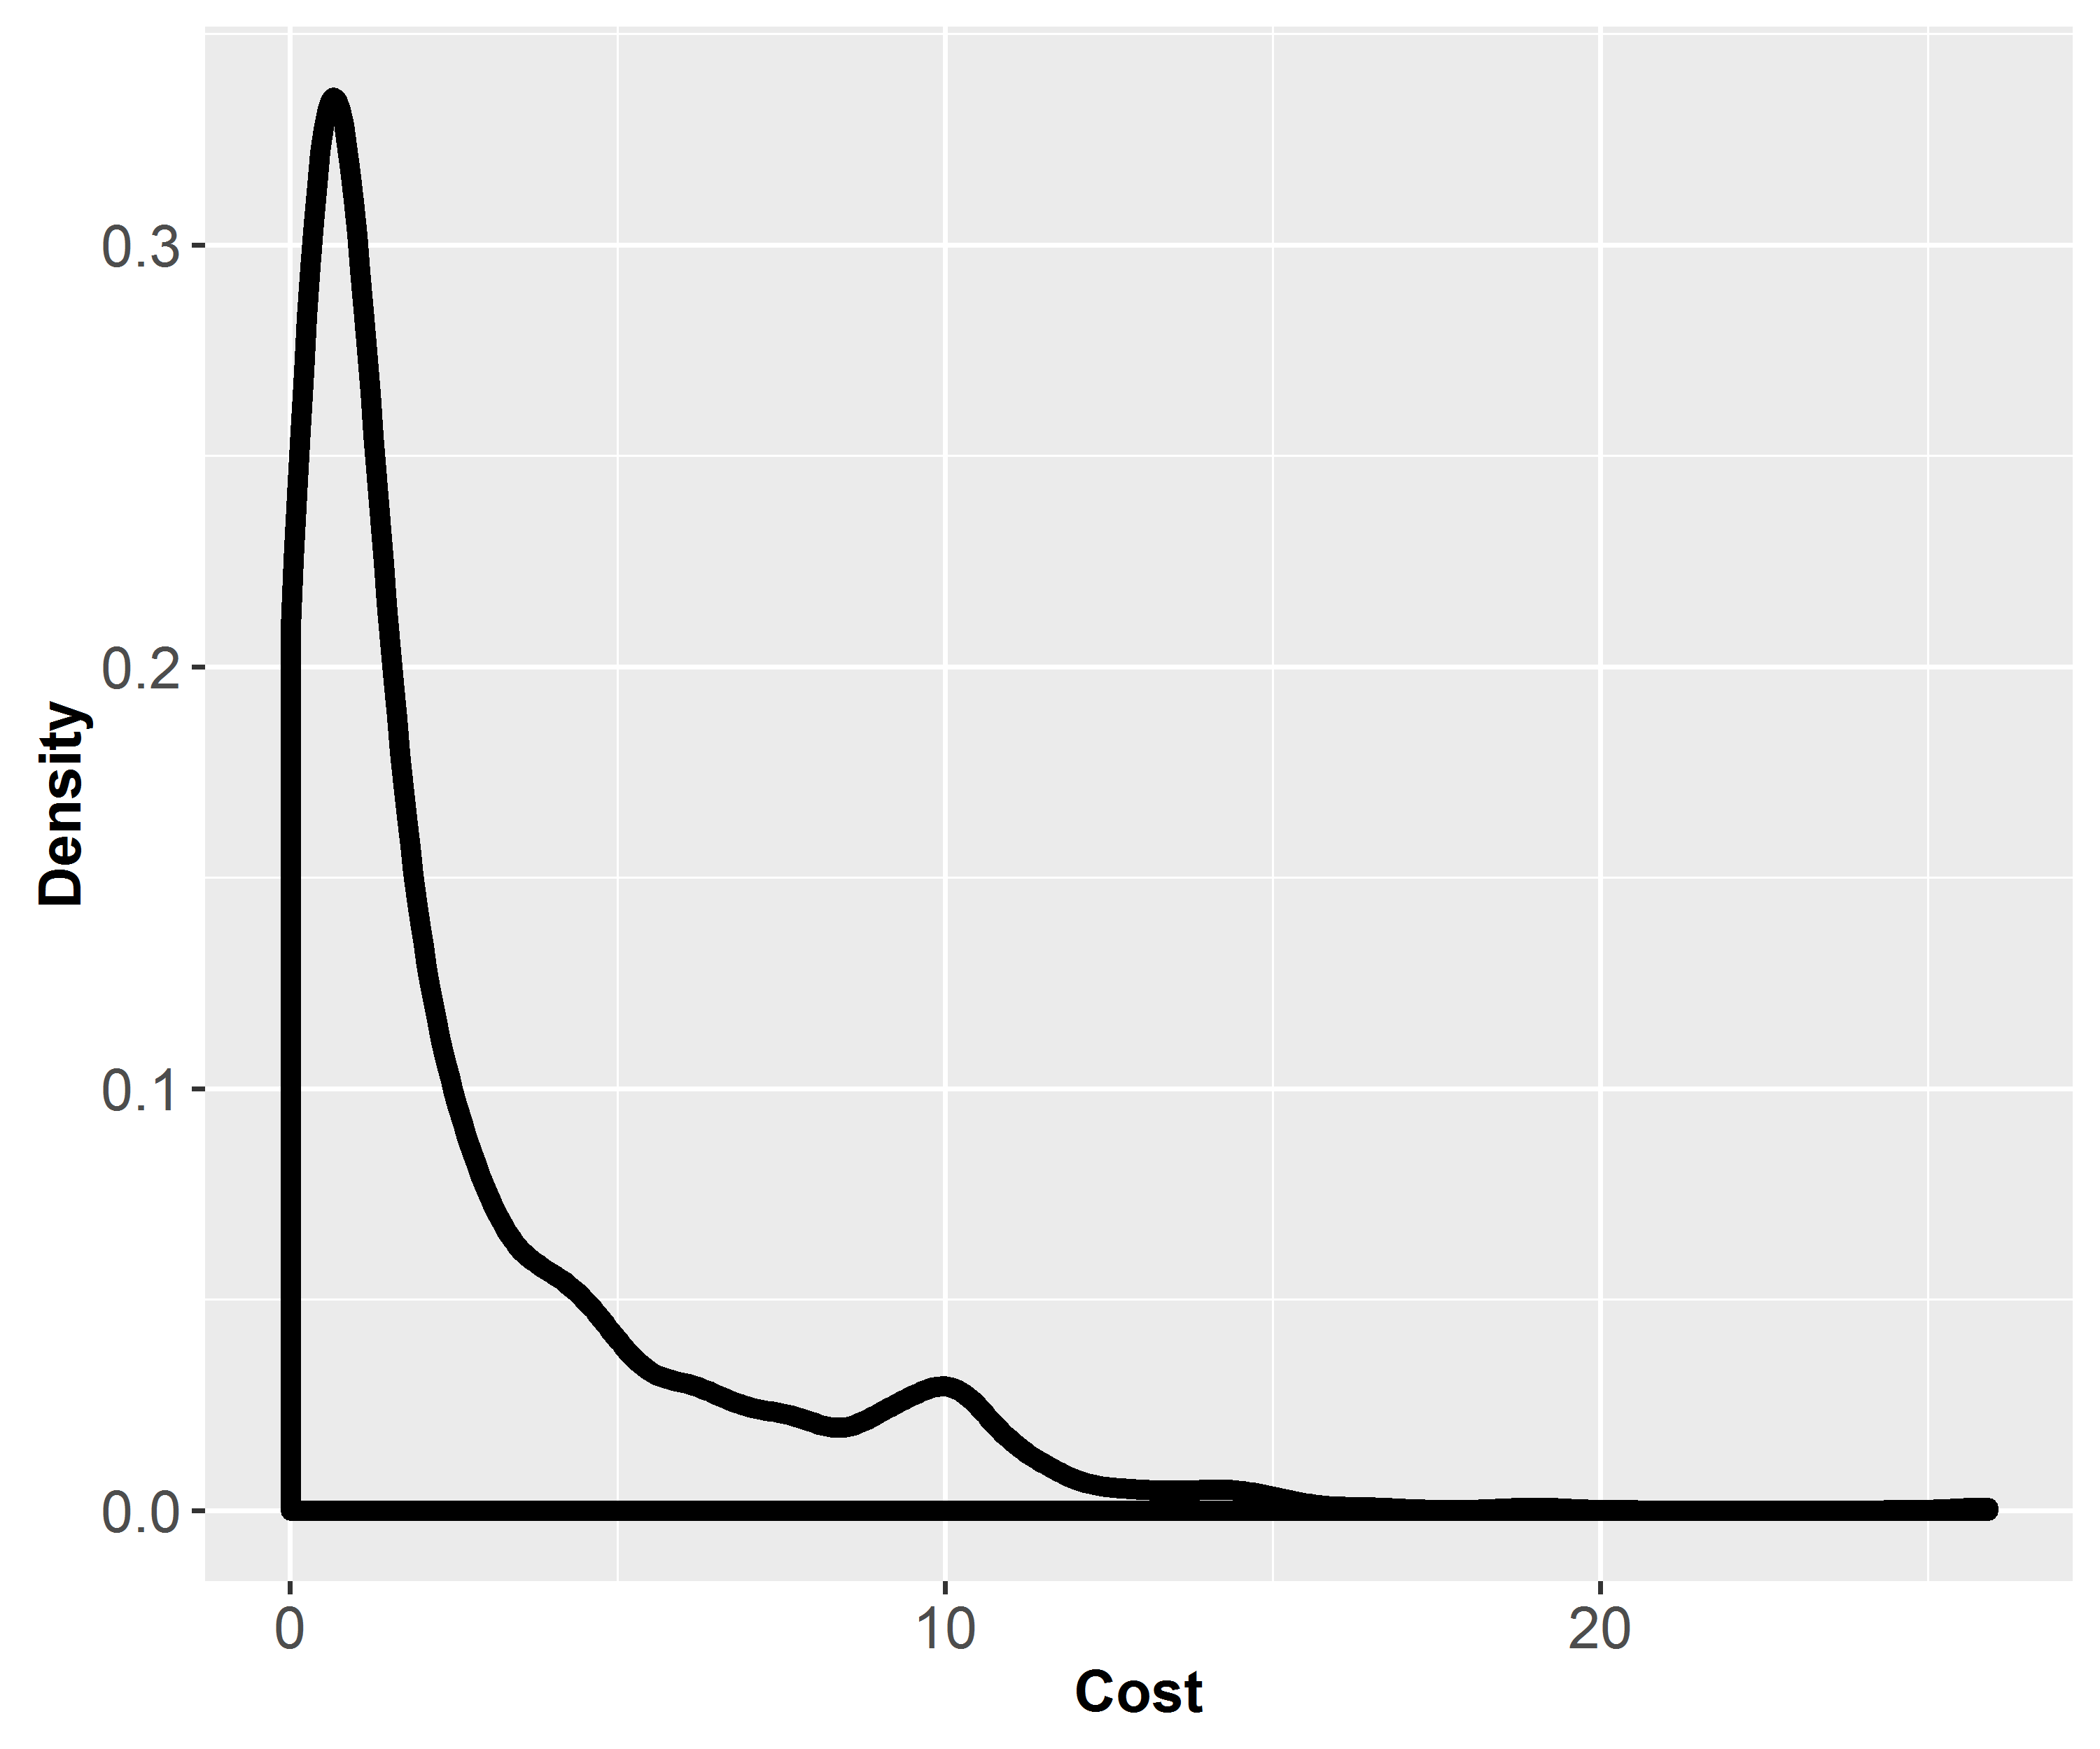
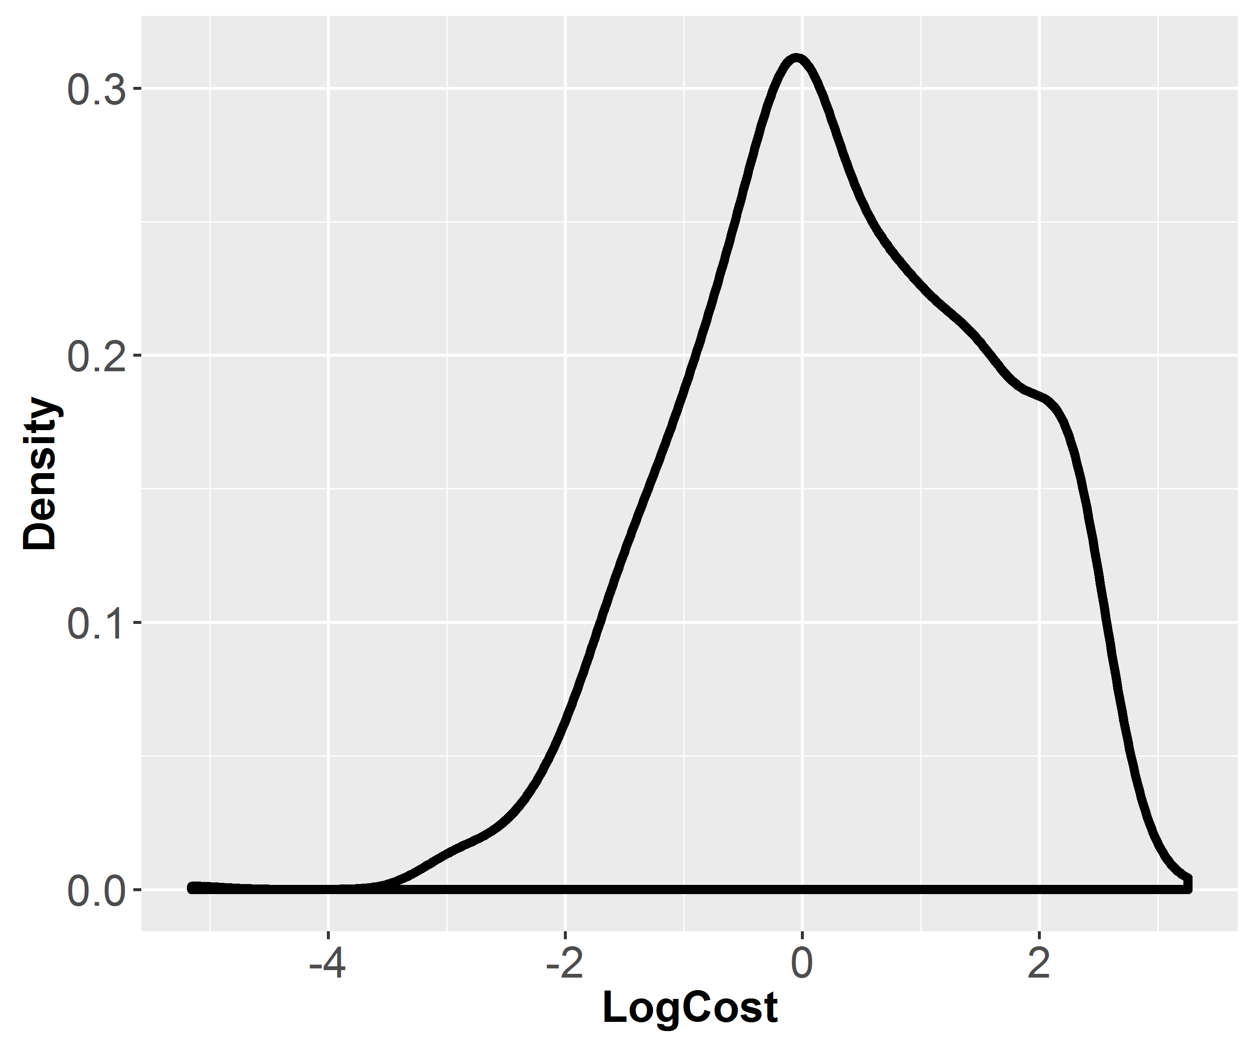
Distribution of COST = ratio of loss to total insured value

Slide 6
Feature Selection:
4 categories of features, which totals about 300+ features.
Policies Characteristics:
Delete features that have more than 50% of missing value
Convert categorical features to dummies
Geodemographics:
Reduced to 2 dimensions derived from PCA trained on scaled vars.
Weather:
Reduced to 2 variables trained on scaled vars using Lasso L1 penalty.
Crime Rate:
Reduced to 2 dimensions derived from PCA trained on scaled vars.

Slide 7
Overall Process
2 PCA Geo
Models Tried:
Logistic Regression
Elastic Net
GBR
GBM
Scaled training Data Sample
(20K Record)
2 PCA-Crime
Raw Data
Weighted Average Blend
2 Weather-trim
(L1 Lasso)
Full Data
Models Tried:
XGBoost - Logistic
XGBoost - Poisson
> 50% available policy variables

Slide 8
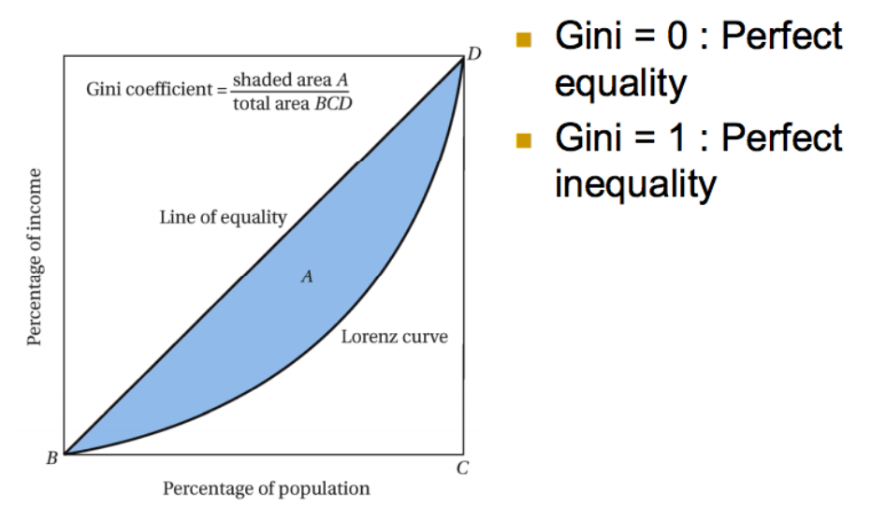
Evaluation method

Slide 9
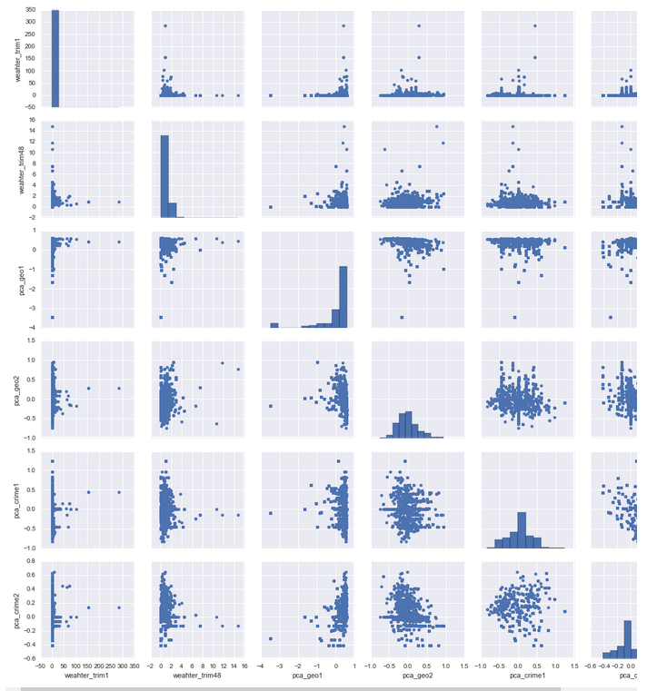
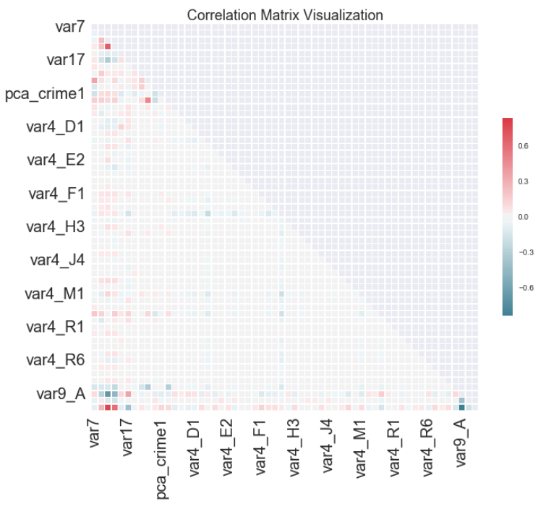
Correlation study

Slide 10
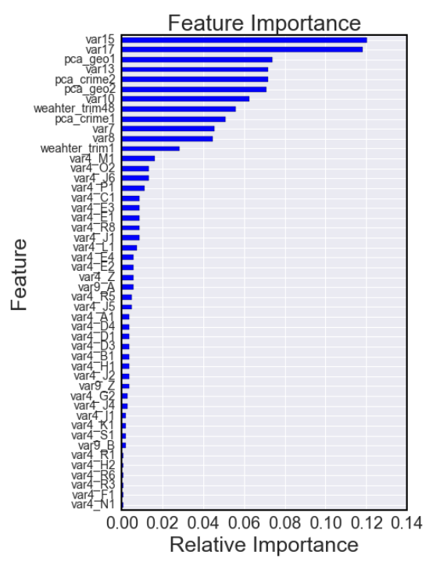
XGBoost Summary Gini=0.303
params2 = {'objective': 'count:poisson',
'eta': 0.05,
'subsample': 0.7,
'max_depth': 6,
'min_child_weight': 1,
'colsample_bytree': 0.5,
'gamma': 5,
'silent': 1
}
folds = 5
num_round = 24

Slide 11
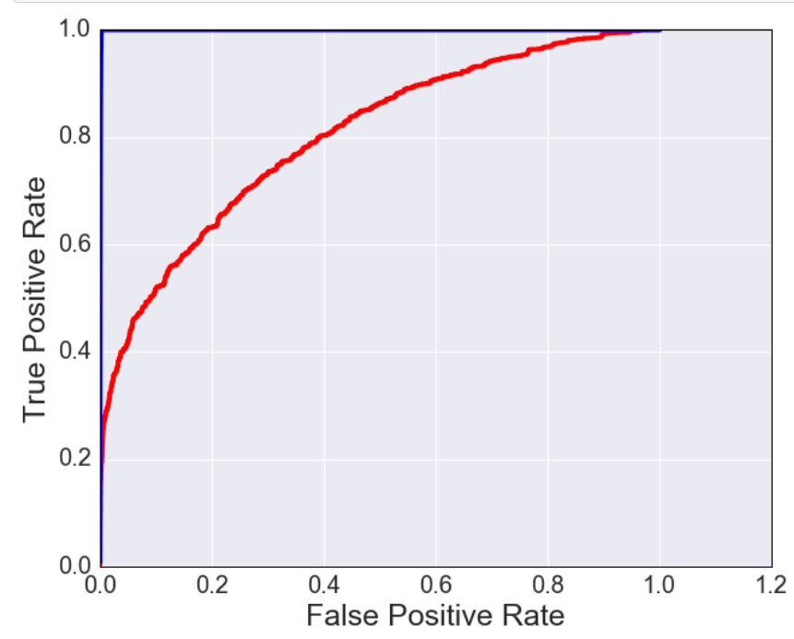
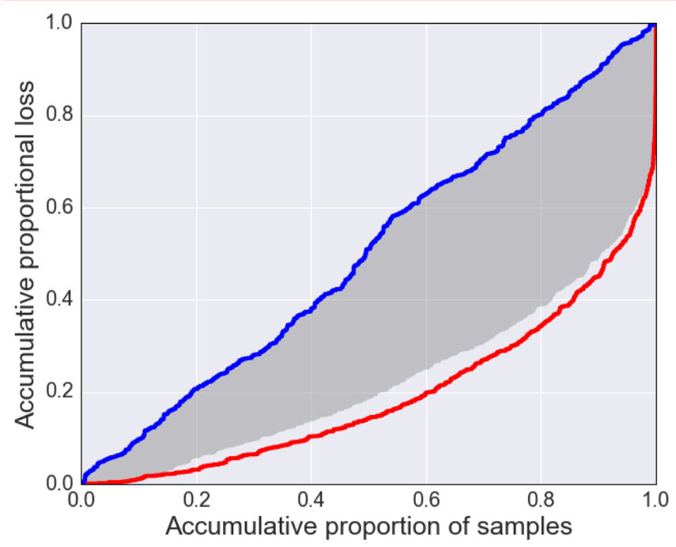
XGB results
GINI =A/(A+B)
A
B

Slide 12
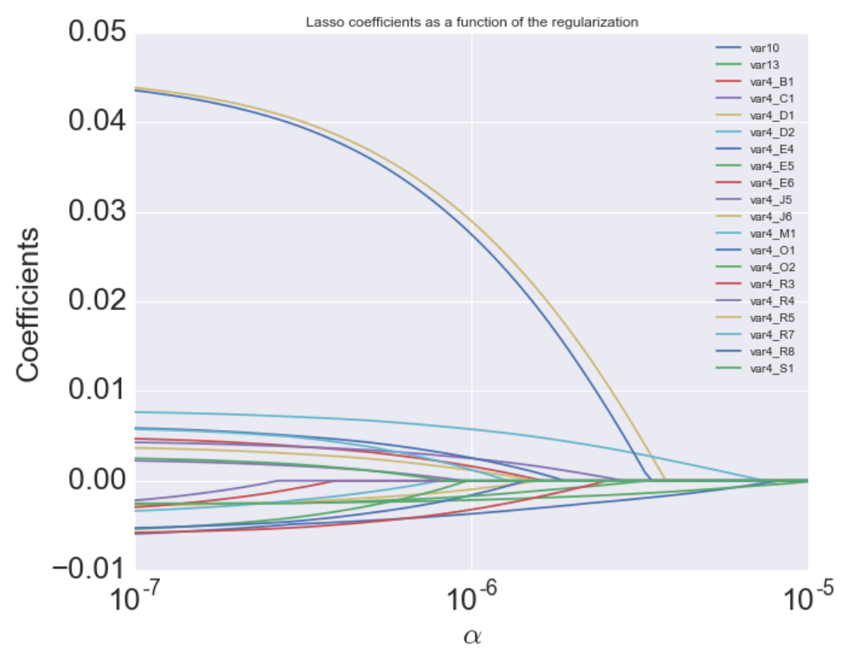
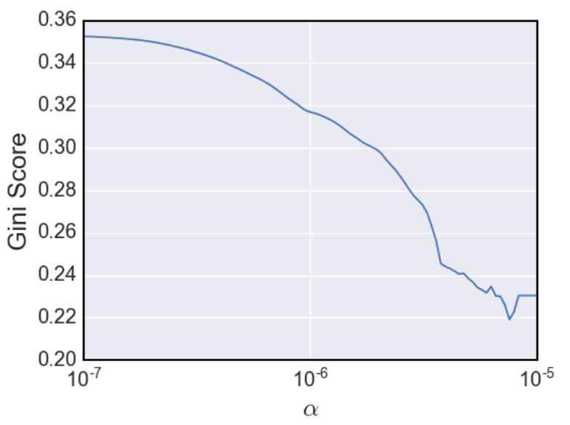

LinearRegression ElasticNet Gini=0.253
elastic = linear_model.ElasticNet (l1_ratio =0.5,normalize=True)
elastic.set_params (alpha = 1e-7)
Output=target

Slide 13
GradientBoostingRegressor Summary: Gini=0.28
GradientBoostingRegressor(alpha=0.9, init=None, learning_rate=0.05, loss='ls', max_depth=3, max_features=None, max_leaf_nodes=None, min_samples_leaf=1, min_samples_split=2, min_weight_fraction_leaf=0.0, n_estimators=100, random_state=None, subsample=1.0, verbose=0, warm_start=False)
Feature Importance ranking is in line with XGBoost.

Slide 14
Takeaways
Feature selection to reduce noise and increase score
Sampling technique is important with very low signal data.
20K including all zero losses and the 1188 response
Extracting value from blocks of features
Try tune multiple different models quickly and focus on a couple for entire dataset training.
Log transformation on the target didn’t improve the overall result
Our best score with single model is 0.3, which is close to the No1 (0.33) on the board;
Model stacking will be done to further improve the overall performance

Slide 15
Backup slides

Slide 16

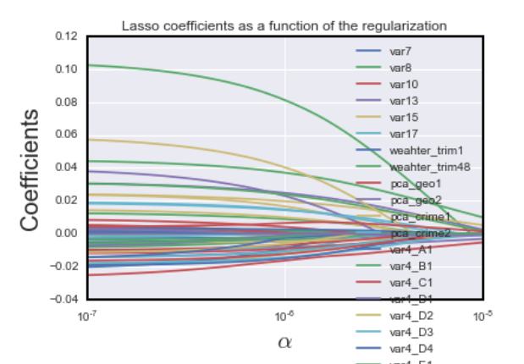
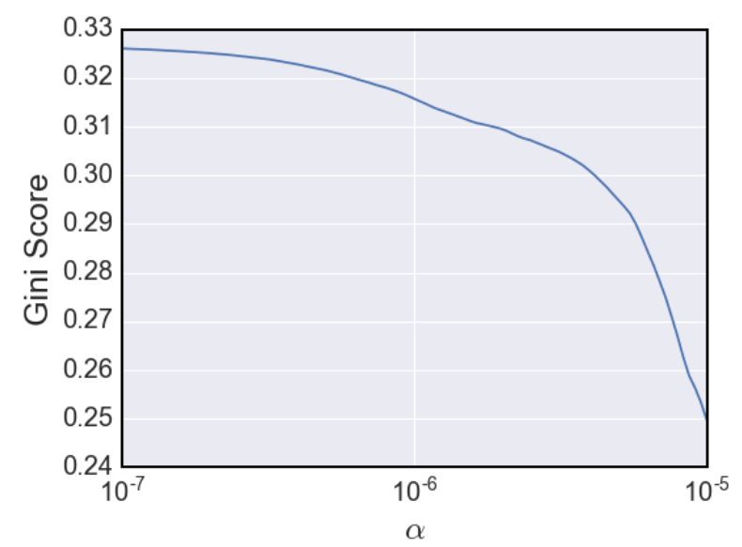
Linear regression, ElasticNet, fine steps,logloss
elastic = linear_model.ElasticNet(l1_ratio =0.5,normalize=True)
elastic.set_params(alpha = 1e-7)
elastic.fit(X_train,y_train)

Slide 17
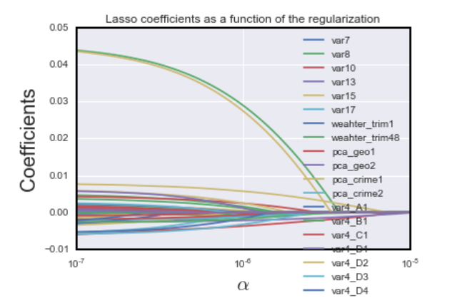
Linear regression, ElasticNet, target
elastic = linear_model.ElasticNet(l1_ratio =0.5,normalize=True)
elastic.set_params(alpha = 1e-7)

Slide 18
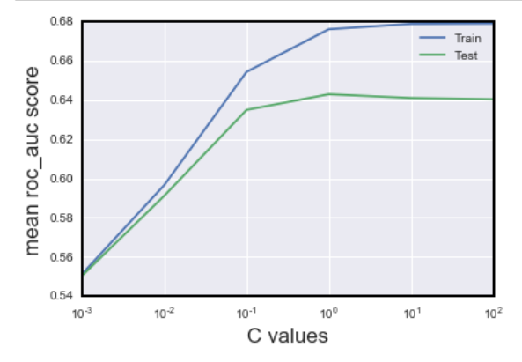
Logistic regression, Gini=0.223
Logit_best = Pipeline([('scale', MinMaxScaler()), ('classifier', LogisticRegression())])
Logit_best.set_params(classifier__C=0.5)
Ruonan Logistic Regression got 0.21 on the leaderboard too.

Slide 19
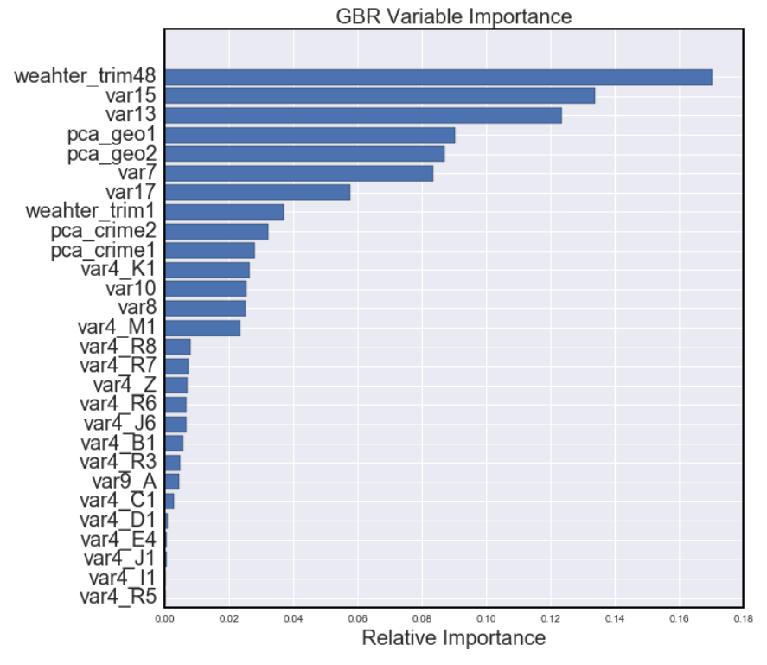

GradientBoostingRegressor
(n_estimators=100, learning_rate=0.05)
Frank use the target.
Ruonan use log-target.

Slide 20

GradientBoostingClassifier
gbc_best = GradientBoostingClassifier(n_estimators=120,
learning_rate=0.05, random_state= 2015)
Convert target into binary and use the predict_prob as outcome.

